Slide 1


Slide 2


Slide 3
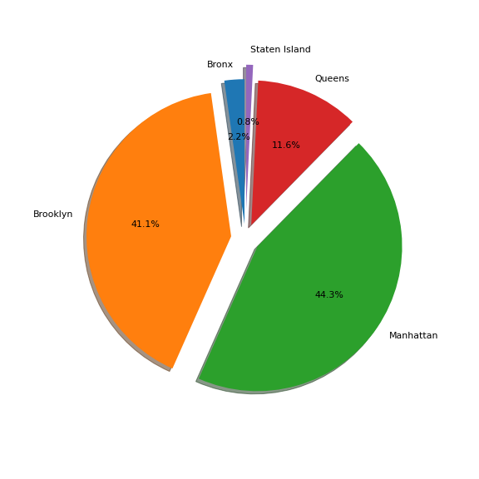
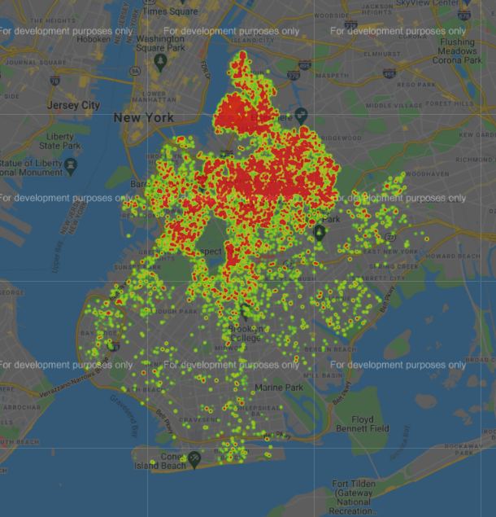
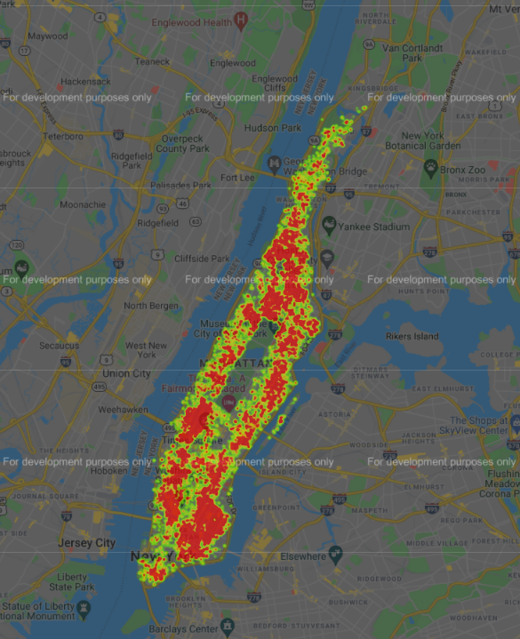
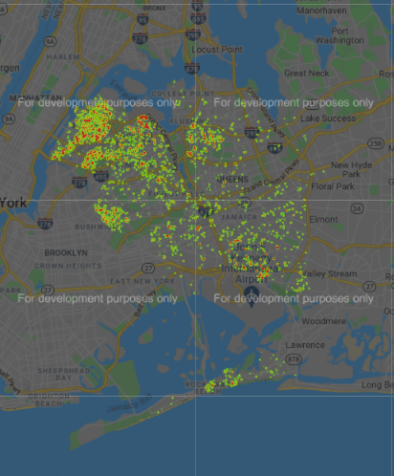
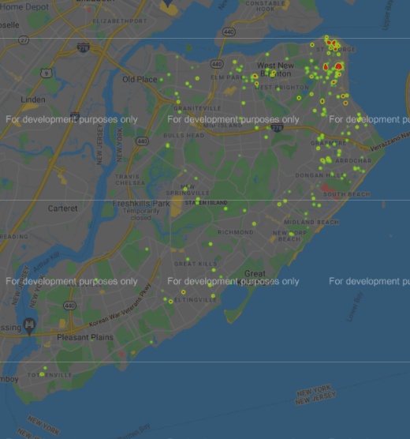
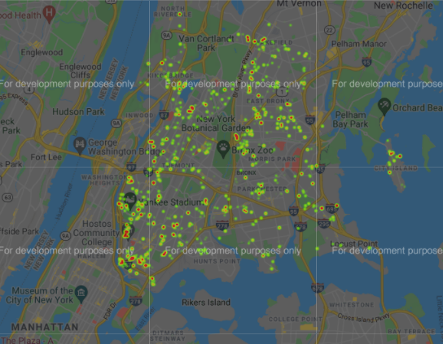
Number of Reviews by Borough
Brooklyn
Manhattan
Queens
the Bronx
Staten Island

Slide 4
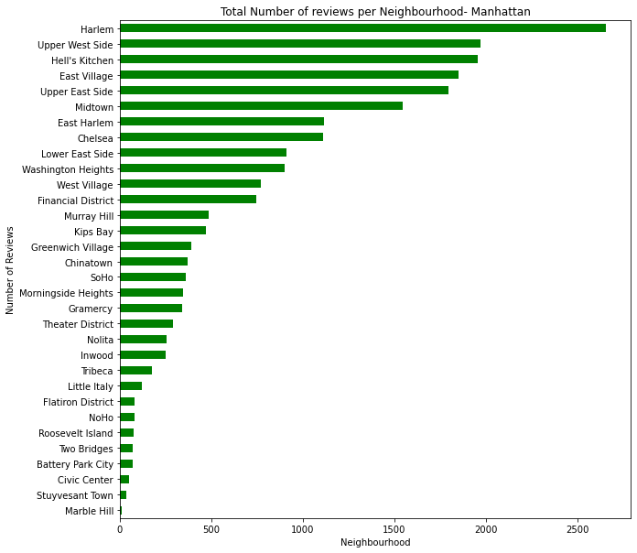
Manhattan
Top number of reviews
21,661 total reviews
20.99 mean number of reviews

Slide 5
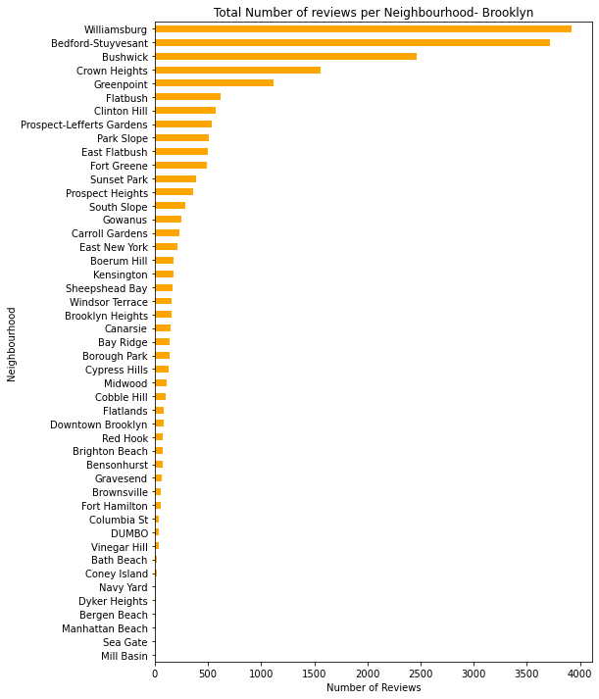
Brooklyn
20,104 total reviews
24.20 mean number of reviews

Slide 6
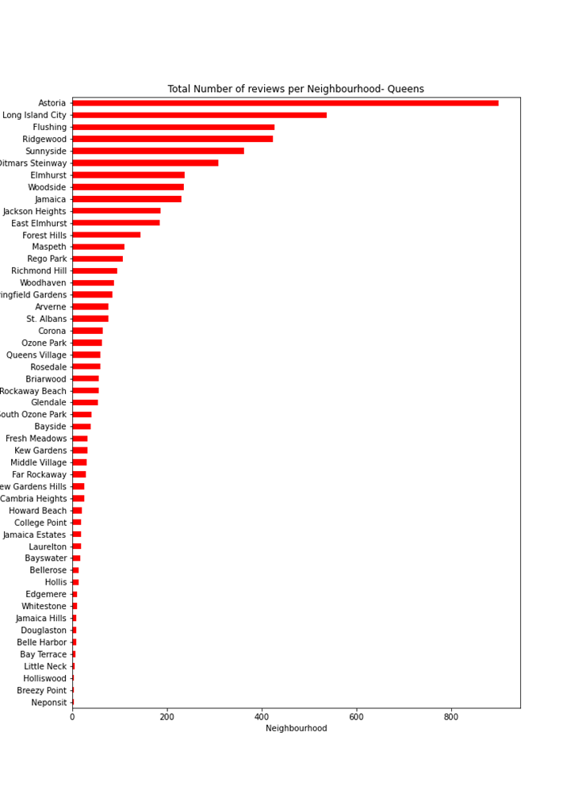
Queens
5666 total reviews
27.70 mean number of reviews

Slide 7
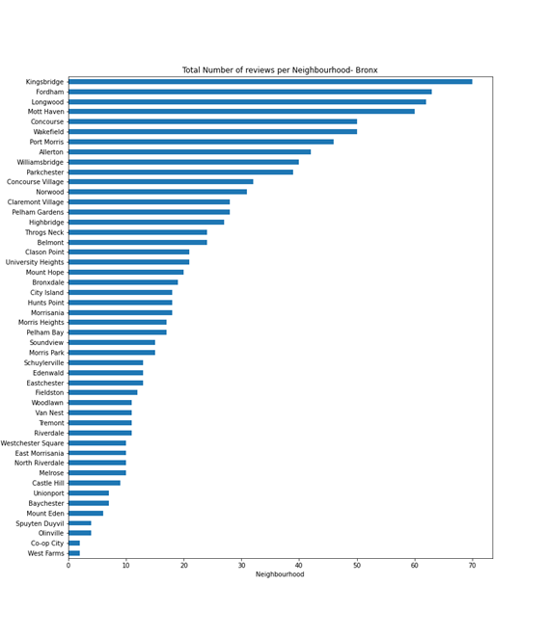
Bronx
1091 total reviews
26.00 mean number of reviews

Slide 8
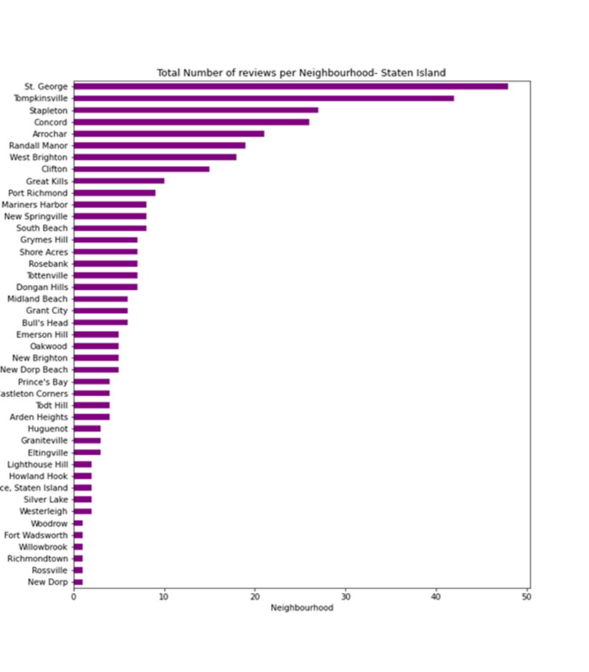
Staten Island
Least number of reviewed properties.
373 total reviews
30.94 mean number of reviews

Slide 9
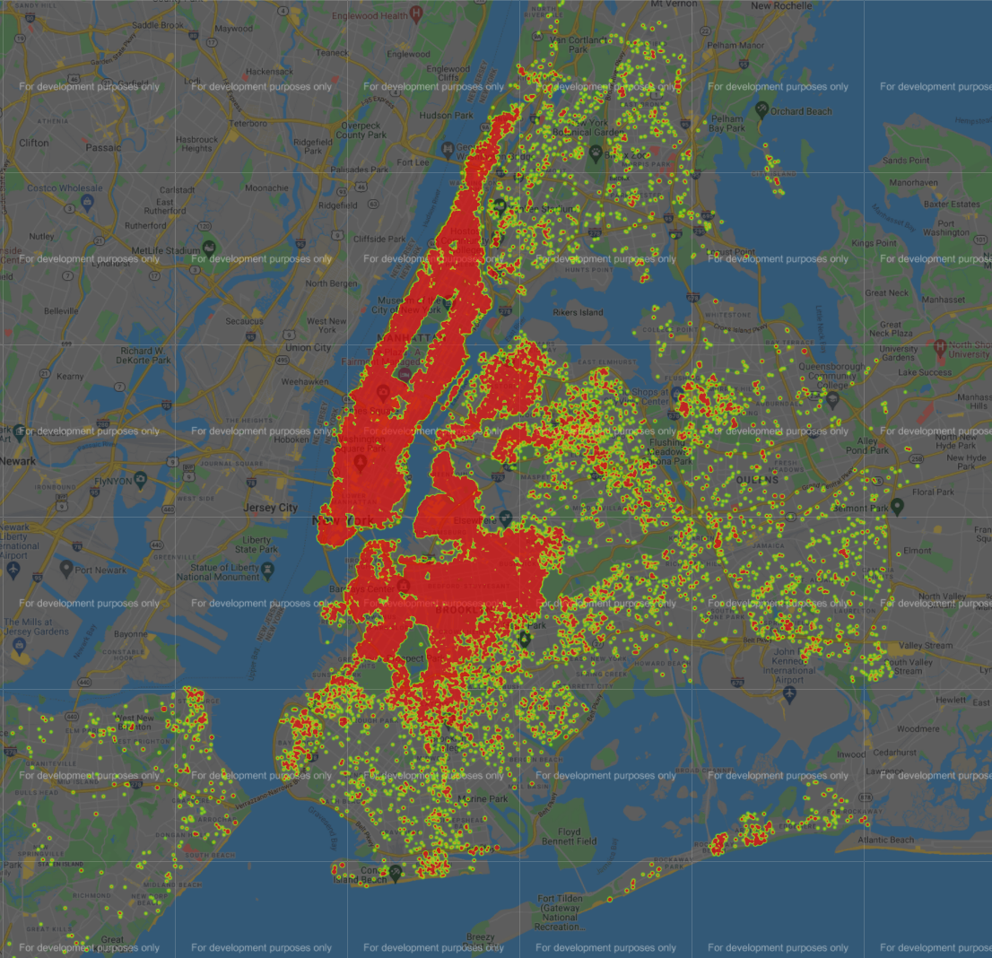
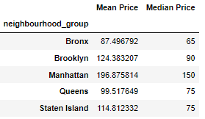
Prices by Borough
Text here

Slide 10
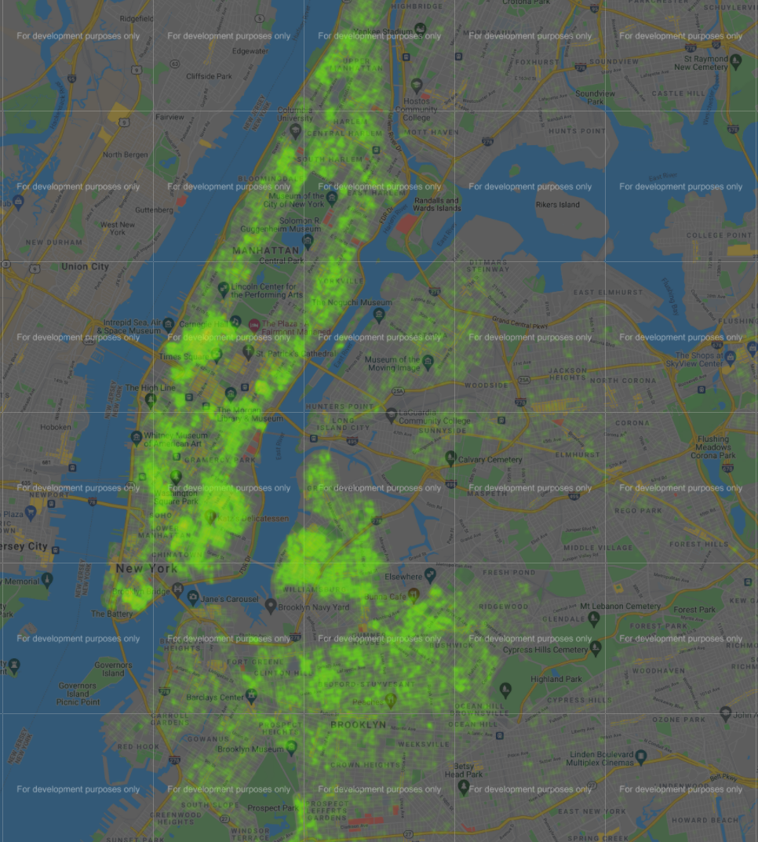
Subway Stations

Slide 11
Two sample T-test: the mean income of Manhattan and Brooklyn

